Slide 1
MACHINE LEARNING
LOGISTIC REGRESSION

Slide 2
paying back the debt
1 / YES
0 / NO
balance on credit
card
100$
1000$

Slide 3
paying back the debt
1 / YES
0 / NO
balance on credit
card
100$
1000$
Linear regression is not a good approach!

Slide 4
paying back the debt
1 / YES
0 / NO
balance on credit
card
100$
1000$
Sensitive to outliers: now the linear regression model is going to give us very
bad predictions !!!

Slide 5
The p(x) = Pr(default=1 | balance = x ) is the probability of default when we
know the balance !!!
b0+b1*x
e
p(x) =
„sigmoid function”
b0+b1*x
1 + e
It has a value between 0 and 1 !!!
Logistic regression fits the b0 and b1 parameters, these are the
regression parameters
This fitted curve is not linear: we can make it linear with the help
of the logit transformation

Slide 6
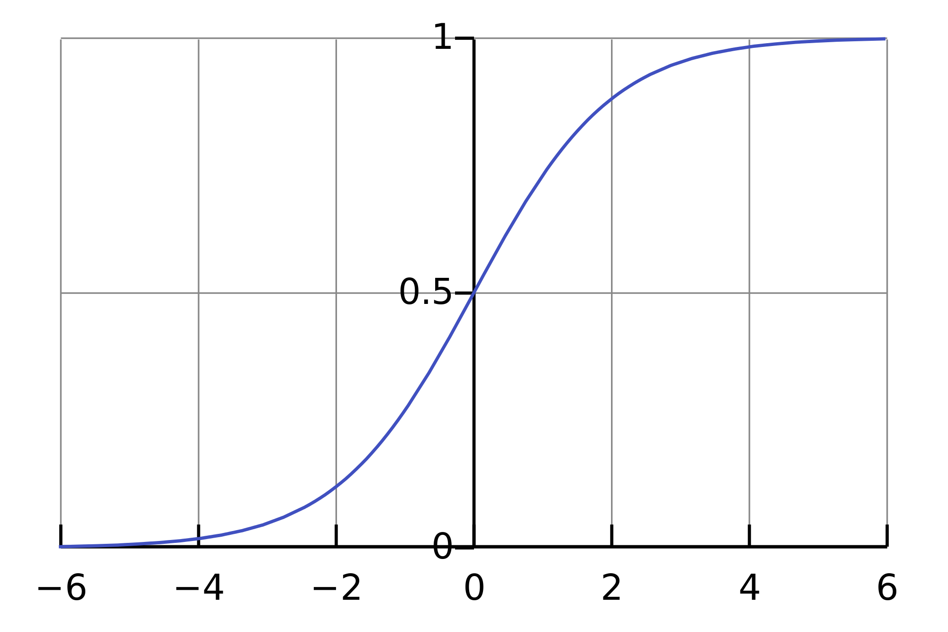
Logistic function

Slide 7
logit p(x) =
b0+b1*x
„logit transformation”
p(x)
log (
) = b0+b1*x
1 -
p(x)
The point of the logit transformation is to make it linear: so logistic regression is a linear
regression on the logit transform !!!
How to fit the parameters?
- maximum likelihood method
- gradient descent method

Slide 8
Multivariate logistic regression
We try to make some predictions -> whether the given person will default or not
We have some data -> income + balance + age // 3 features !!!
b0+b1*x1+b2*x2+...+bn*xn
e
p(x) =
b0+b1*x1+b2*x2+...+bn*xn
1 + e

Slide 9
y: paying back the debt
1 / YES
0 / NO
X: balance on
credit card
100$
1000$
It is better: it is between [0:1]. We want to assign a probability to each balance

Slide 10
y: paying back the debt
1 / YES
„logistic function” or sigmoid
0 / NO
X: balance on
credit card
100$
1000$
It is better: it is between [0:1]. We want to assign a probability to each balance

Slide 11
1
sigmoid function
g(z) =
- z
1 + e
1
h (x) =
g(z) =
Linear model when
z = ß0 + ß1*x
ß
-( ß0 + ß1*x )
1 + e
g( z=-inf ) = 0
g( z=0 ) = 0.5
g( z=inf ) = 1
This sigmoid function is always in the interval [0:1] so it is good
for predicting probablilities !!!

Slide 12
Logistic regression
It is a linear classifier !!!
We have to fit the ß parameters first, after that the g(z) is going to give us the predictions
h(x) is the hypothesis -> it is going to tell us the probability of y=1 when we have the given x input
h(x) >= 0.5 → y=1 // no default
h(x) < 0.5 → y=0 // default
IT IS THE SAME AS:
z < 0 default
z > 0 no default
z = 0 „decision boundary”

Slide 13
x2
x1

Slide 14
x2
x1
This is the
decision boundary

Slide 15
x2
y=1
y=0
x1
This is the
decision boundary

Slide 16
x2
h (x) = g( ß0 + ß1 * x1 + ß2 * x2 )
this is our model
ß
y=1
We can calculate the ß values with the
help of gradient descent !!!
y=0
x1
ß0 = -3
ß1 = 1
ß2 = 1
This is the
decision boundary
-3 + x1 + x2 = 0 this is the decision boundary
x2 = 3 – x1

Slide 17
x2
h (x) = g( ß0 + ß1 * x1 + ß2 * x2 )
this is our model
ß
y=1
We can calculate the ß values with the
help of gradient descent !!!
y=0
x1
ß0 = -3
ß1 = 1
ß2 = 1
This is the
decision boundary
-3 + x1 + x2 = 0 this is the decision boundary
x2 = 3 – x1

Slide 18
x2
x1

Slide 19
x2
2
2
h (x) = g( ß0 + ß1 * x + ß2 * x )
this is our model
ß
1
2
x1

Slide 20
x2
2
2
h (x) = g( ß0 + ß1 * x + ß2 * x )
this is our model
ß
1
2
This is the decision boundary now
x1

Slide 21
y=0
x2
2
2
h (x) = g( ß0 + ß1 * x + ß2 * x )
this is our model
ß
1
2
y=1
This is the decision boundary now
x1

